Slide 1

International Debt Dataset Analysis
Debt owned by The World Bank

Slide 2
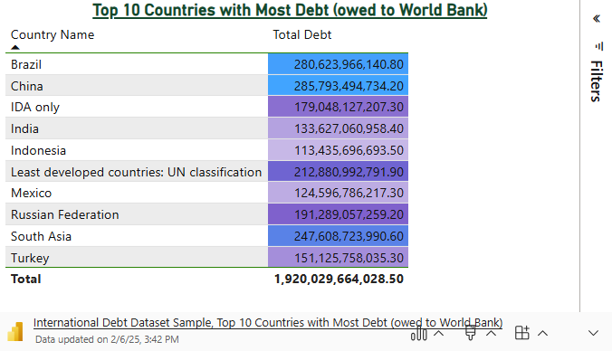
Top 10 Countries with Most Debt
China is the country with most amount of external debt held by The World Bank.
There is a significant drop in total external debt after the top 3 countries in this list.
Follow-up analysis to find out the cause for the drop would be the next recommended step.

Slide 3
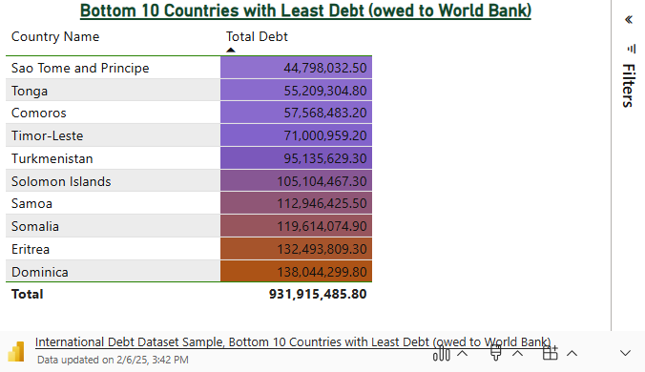
Bottom 10 Countries with Least Debt
Sao Tome and Principe is the country with least amount of external debt held by The World Bank.
These particular countries likely have comparatively small external debts since they have much smaller populations than those higher on the list.

Slide 4
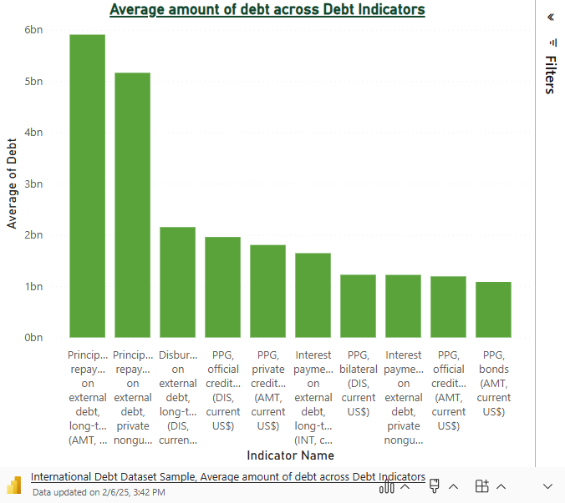
Average Amount of Debt Across Debt Indicators
Principal Repayment on external debt, long-term (AMT, current $US) is the debt indicator with highest average amount of debt held by The World Bank.
Majority of debt indicators with highest average amounts relate to repayments or interest payments on external debt.

Slide 5
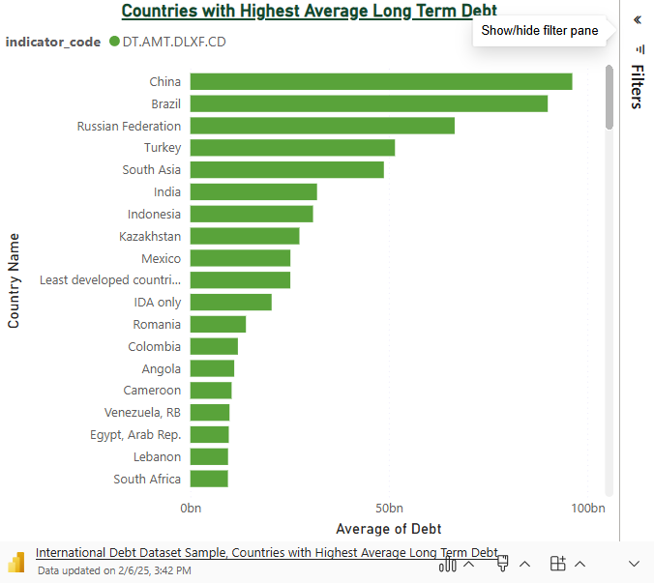
Countries with Highest Average Long Term Debt
China and Brazil are the two top countries with highest average long term debt.
India is ranked 6th on the list. Follow up analysis would be to find out why it is not ranked higher.

Slide 6
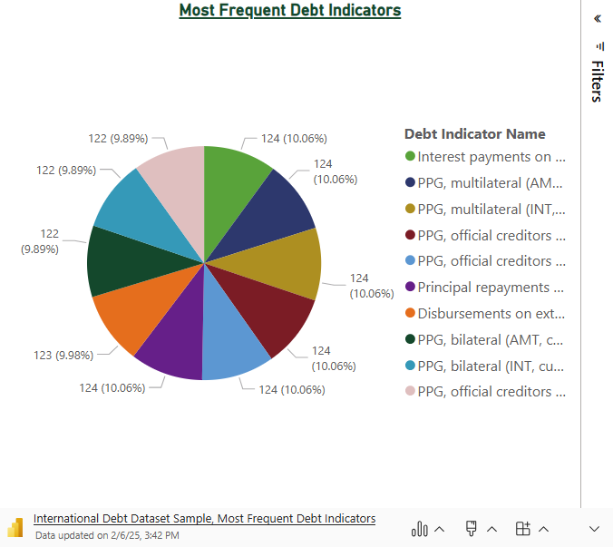
Most Frequent Debt Indicators
The most frequent debt indicators are related to interest payments or reimbursements on the external debt.
PPG, multilateral stands for public and publicly guaranteed loans and credits from multilateral and intergovernmental agencies like the World Bank or regional dev. Banks.

Slide 7
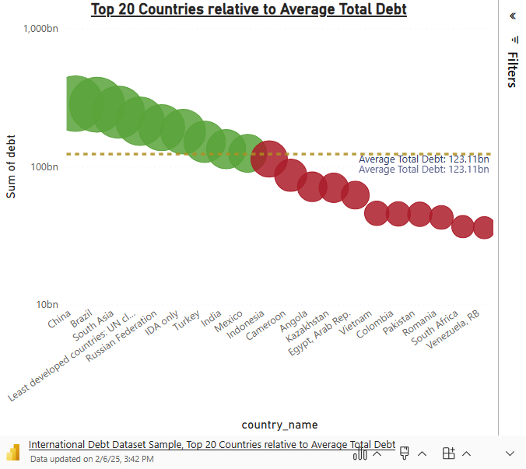
Top 20 Countries Relative to Average Total Debt
The countries with Green bubbles have total debts that are above the Average Total Debt
The countries with Red bubbles have total debts that are below the Average Total Debt

Slide 8

Link to GitHub Project Page
International Debt Statistics GitHub Project Page

